Slide 1

Social Security Benefits Training
2020
Presented by:
Hillary Hatch
Area Work Incentive Coordinator, SSA

Slide 2

Disability Programs
Title II
SSDI
Social
Security Disability Insurance
Medicare
Title XVI
SSI
Supplemental Security
Income
Medicaid

Slide 3

Social Security’s Definition of Disability
A medical condition or combination of impairments preventing substantial gainful activity for at least 12 months, or expected to result in death. The determination also considers age, education & work experience.
www.socialsecurity.gov

Slide 4

What is Substantial Gainful Activity?
Work is “substantial” if it involves doing significant physical or mental activities or a combination of both.
If your impairment is anything other than blindness, earnings averaging over $1,260 a month generally demonstrate SGA. Blind SGA is $2,110.
www.socialsecurity.gov

Slide 5
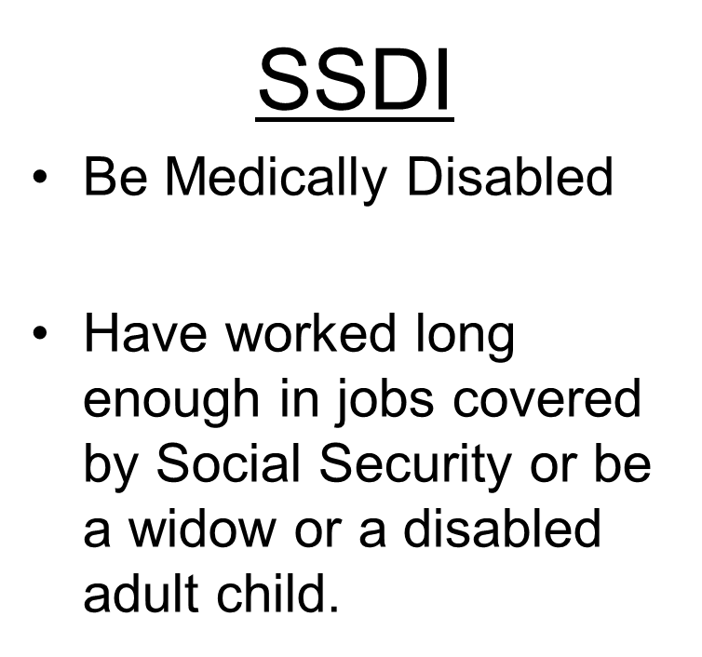
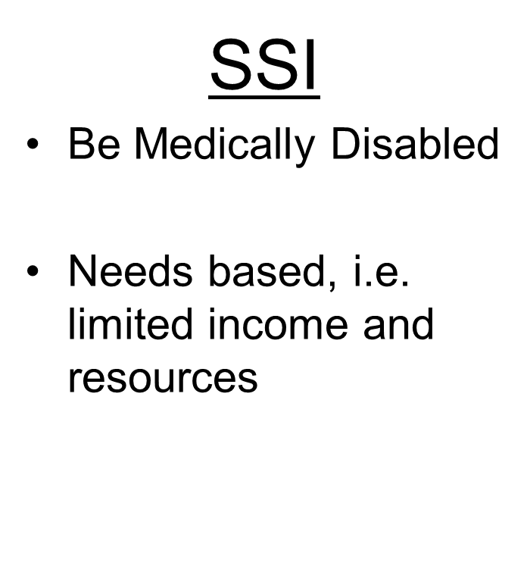
Eligibility Requirements
www.socialsecurity.gov

Slide 6
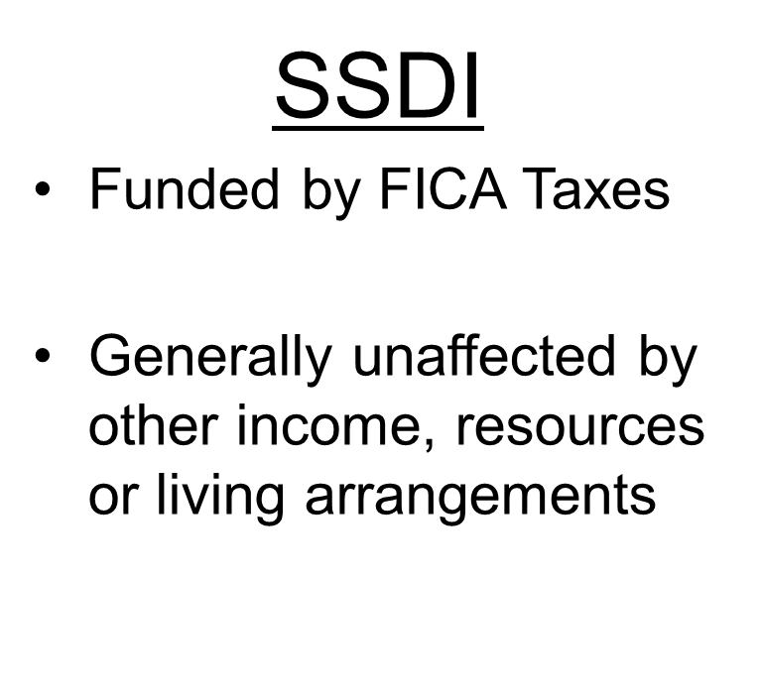
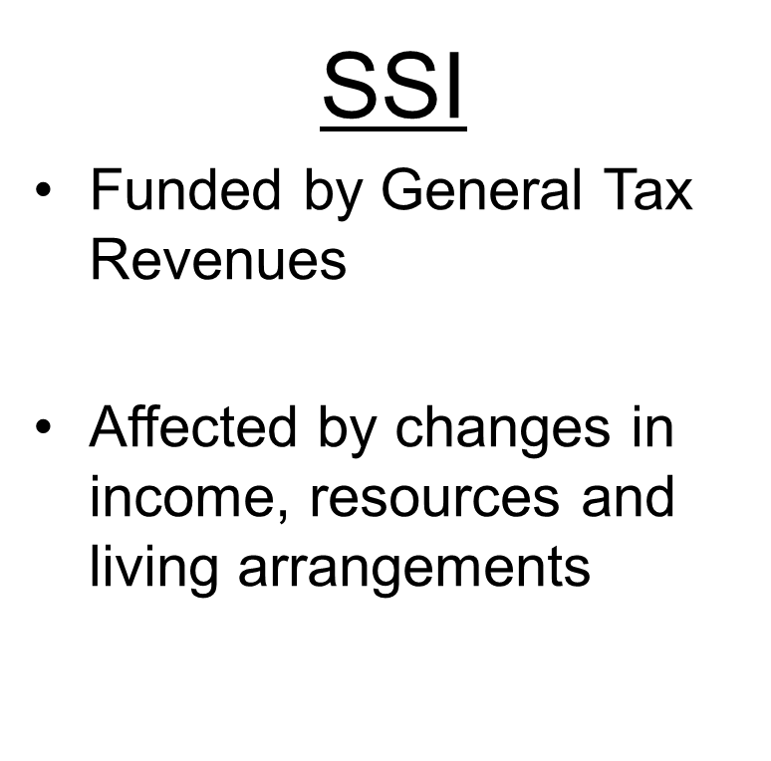
Eligibility Requirements
www.socialsecurity.gov

Slide 7
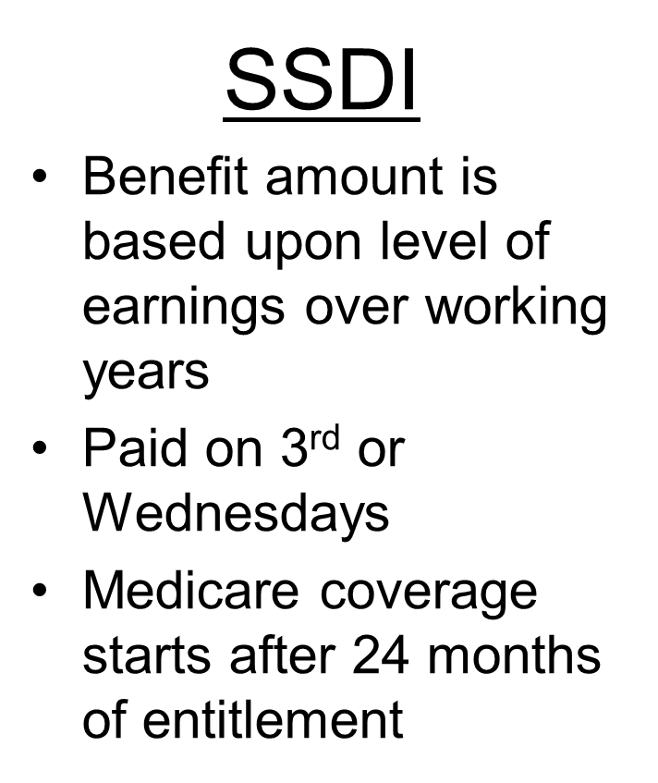
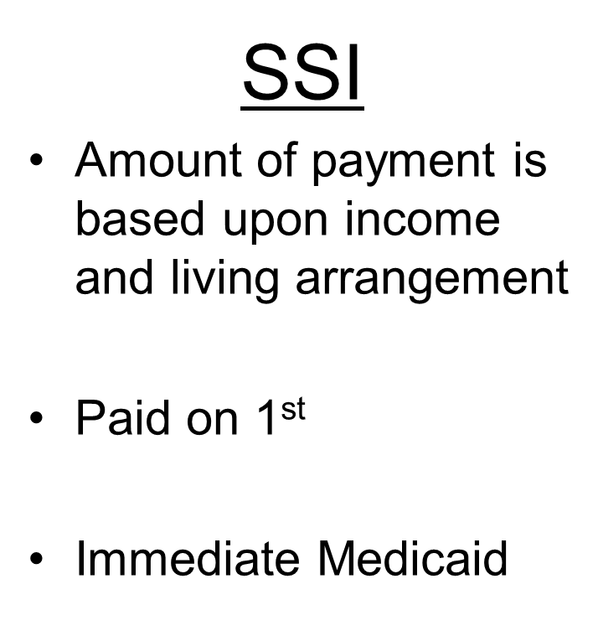
Eligibility Requirements
www.socialsecurity.gov

Slide 8

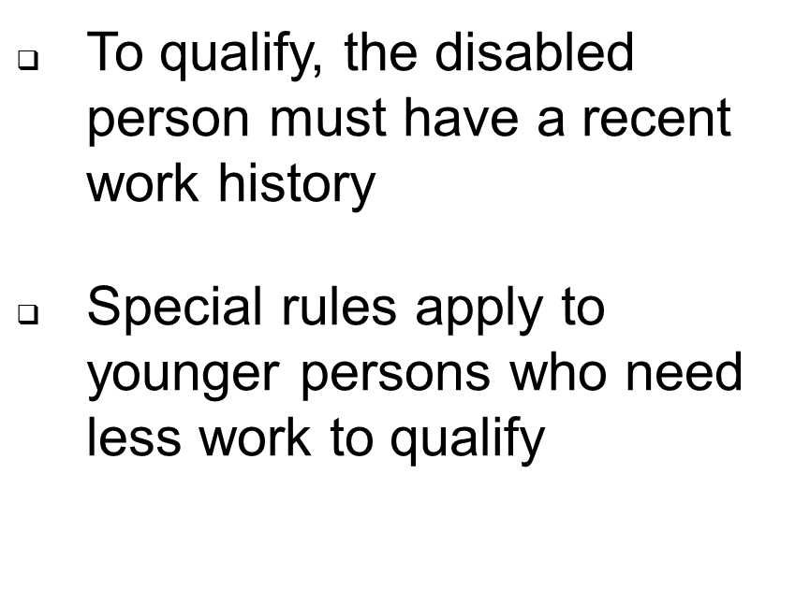
Social Security Disability Insurance (SSDI)
www.socialsecurity.gov

Slide 9
Work Credits
When you work and pay Social Security taxes, you earn up to a maximum of 4 work credits each year.
The work credits are based on the total amount of your wages or self-employment income during the year.
For each $1,410 in gross earnings you get one credit, max. of 4 credits per year.
Earn $5,640 to earn 4 credits in 2020.
www.socialsecurity.gov

Slide 10
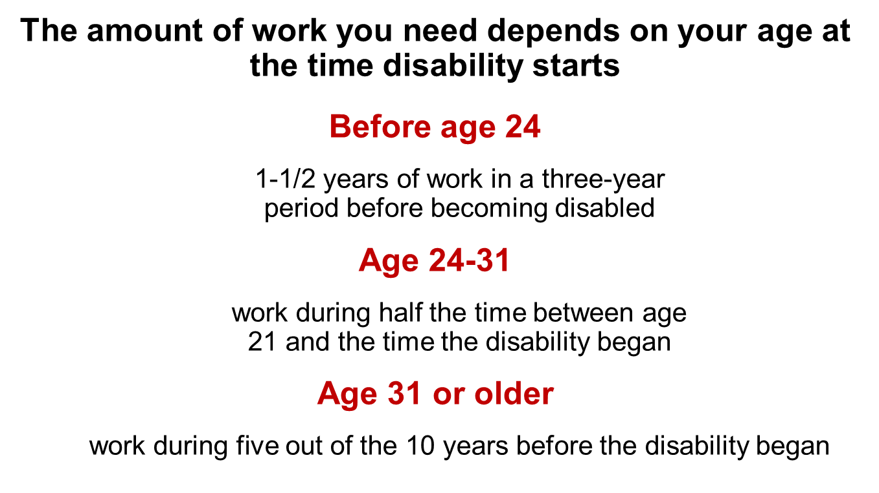
Work Requirements
www.socialsecurity.gov

Slide 11
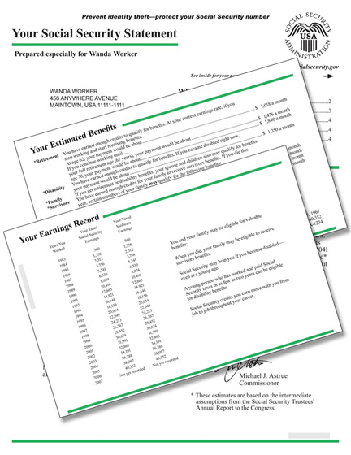
Amount of Benefit
Benefits are calculated based on your entire
work history
If your Social Security benefit amount is lower than the full SSI payment, you may be eligible to receive both Social Security and SSI
www.socialsecurity.gov

Slide 12
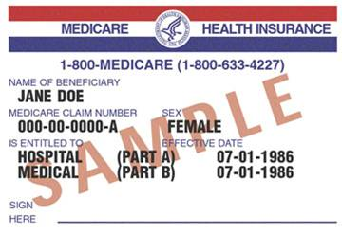
Medicare
Medicare coverage automatically begins after being entitled to disability benefits for 24 months.
Example: Month of eligibility is 01/2015 – Medicare A&B effective 01/2017
We will send you information about Medicare several months before your coverage starts.
Note: People who have permanent kidney failure requiring dialysis or a transplant or have amyotrophic lateral sclerosis (Lou Gehrig’s disease) may qualify for Medicare almost immediately.
www.socialsecurity.gov

Slide 13

Benefits for the Family
Spouse
At age 62
At any age if caring for child under 16 or disabled
Divorced spouses may qualify
Child
Not married under age 18 (under 19 if still in high school)
Not married and disabled before age 22
www.socialsecurity.gov

Slide 14
What is Supplemental Security Income?
Supplemental Security Income (SSI) pays monthly benefits to individuals with limited income and resources –
    Aged - 65 or older
    Blind - any age
    Disabled - any age
2020 Monthly Benefit Amount = $783
It provides cash to meet basic needs for food, clothing, and shelter
www.socialsecurity.gov

Slide 15

SSI Eligibility Requirements
Have little or No Resources
Be Disabled
Have limited income
Be a U.S. Citizen or
“Eligible alien”
Reside in the U.S.
www.socialsecurity.gov

Slide 16
What are Resources?
Included Resources
Bank Accounts (CDs, IRAs)
Stocks, Bonds, 401Ks (Liquid Assets)
Second Car
Life Insurance
Property other than where you live
Excluded Resources
Home in which you live
First car
Burial plots for self & family
Some resources set aside for burial
ABLE Account (up to $100,000)
Individual Limit
$2,000
Couple’s Limit
$3,000
www.socialsecurity.gov

Slide 17
What is Income?
Earned
Wages
Self-employment
Unearned
SSA benefits
Veterans benefits
Unemployment benefits
Interest
Pensions
Cash from family/friends
www.socialsecurity.gov

Slide 18

Living Arrangements
Living arrangement is another factor used to determine how much Supplemental Security Income (SSI) a person can get.
This means your SSI benefits may vary depending on where a recipient lives:
In someone else’s household
In an institution
    generally $30/month maximum
In a group care or board and care facility

Slide 19

SSI benefits for Children under Age 18
Must have a physical or mental impairment (or combination) that results in marked and severe limitation in functioning
Condition must be expected to last at least 12 months or result in death

Slide 20

SSI Eligibility for Children
Disabled children living in limited income and resources households may be eligible to receive (SSI) benefits.
For eligibility, we look at the income and assets of the disabled child and parent(s) living in the household.

Slide 21
Deemed Resources
The process of determining how much of a parent(s) income and resources will count is called deeming.
Deeming applies when:
The child is under 18; and
Lives at home with his or her natural, or adoptive parents(s)
Deeming stops the month after a child turns age 18.

Slide 22

SSI Determination for Children turning 18yrs old
We make a new disability determination using the adult rules.
We no longer count the income and resources of parent(s) for eligibility.
If the child continues to live with parent(s) but does not pay for food or shelter, a lower SSI payment may apply
An SSI application can be made as early as the day of 18th Birthday.

Slide 23

Can You Work While Receiving SSDI/SSI?
2020

Slide 24

What is Substantial Gainful Activity?
Work is “substantial” if it involves doing significant physical or mental activities or a combination of both.
If the impairment is anything other than blindness, earnings averaging over $1,260 a month generally demonstrate SGA.
The SGA amount for blind individuals is $2,110.
www.socialsecurity.gov

Slide 25
What Are Work Incentives?
Employment support provisions to assist beneficiaries in moving from benefit dependency to independence.
Designed to help beneficiaries enter, re-enter, or stay in the workforce by protecting their eligibility for cash payments and/or healthcare.
www.socialsecurity.gov

Slide 26
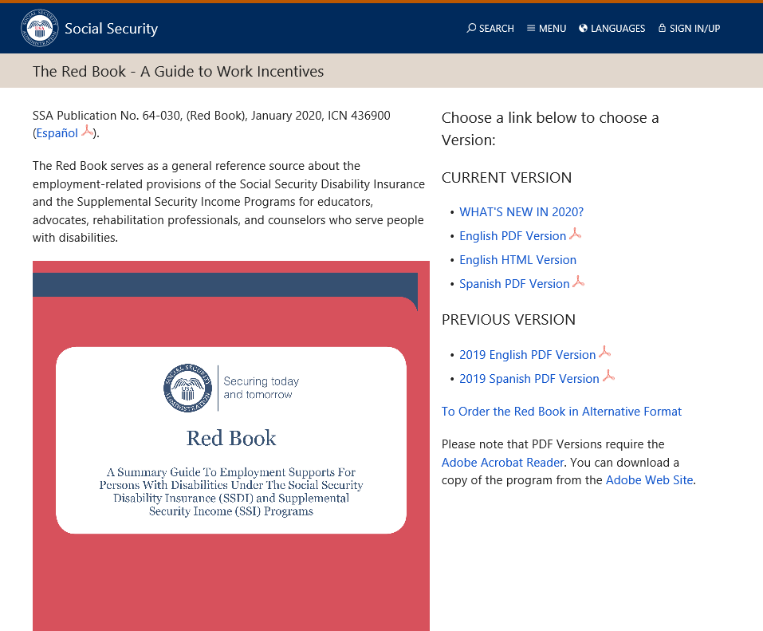
Introducing The Red Book
Serves as general reference tool designed to provide a working knowledge of these work incentives for both SSDI and SSI beneficiaries.
Serves as
www.socialsecurity.gov

Slide 27

SSDI AND SSI EMPLOYMENT SUPPORTS
Subsidies
Special Conditions
Impairment-Related Work Expenses
Work Activity Report
www.socialsecurity.gov
Notes:
Pages 22-25 of The Red Book
We must determine the real value of work

Slide 28
Subsidies and Special Conditions
What is a subsidy?
A “subsidy” is support provided by an employer that may result in receiving more pay than the actual value of the services performed.
What are special conditions?
“Special conditions” refers to support and on the job assistance provided by an employer, or by someone other than the employer, for example, a vocational rehabilitation agency. Because of this support, a person may receive more pay than the actual value of the services performed.
www.socialsecurity.gov

Slide 29
Impairment-Related Work Expenses (IRWE)
We deduct the cost of certain impairment-related items and services that are needed to work from gross earnings when we decide if work is SGA.
The beneficiary must pay for the item themselves (no reimbursement from 3rd party)
The claimant must pay cash (no in-kind payments)
Examples include wheelchairs, certain transportation costs and specialized work-related equipment.
Example: Beneficiary is earning $1300.00 per month in gross wages. His monthly co-pay for his medications is $100.00.
$1300 - $100 = $1200 - This is countable income when determining SGA.
www.socialsecurity.gov

Slide 30
Impairment-Related Work Expenses (IRWE)
Type of Expense | Example
Transportation Costs | The cost of structural or operational modifications to vehicle that is needed to travel to work. The cost of driver assistance or taxicabs if public transportation is not available or not accessible.
Attendant Care Services | Services performed in the work setting. Services performed to help prepare for work, the trip to and from work and after work.
Service Animals | Expenses paid in owning a guide dog or other service animal who enables beneficiary to overcome functional limitations in order to work.
Medical Devices | Deductible devices include wheelchairs, dialysis equipment, pacemakers, respirators, traction equipment, and braces.
Prosthesis | Artificial hip, artificial replacement of an arm, leg, or other parts of the body.
Residential Modifications | Employed outside of home- modifications to exterior to permit access to the street or transportation. Self-employed at home- modifications inside to create workspace to accommodate impairment.
Prescription Drugs | Regularly prescribed medical treatment or therapy that is necessary to control disabling condition. This includes co-payments and insurance deductibles.
Other Items and Services | Assistive technology that people with disabilities use for employment–related purposes; such as software applications, computer support services, and special tools which have been specifically designed to accommodate the person’s impairment
https://secure.ssa.gov/apps10/poms.nsf/lnx/0500820555!opendocument
www.socialsecurity.gov

Slide 31
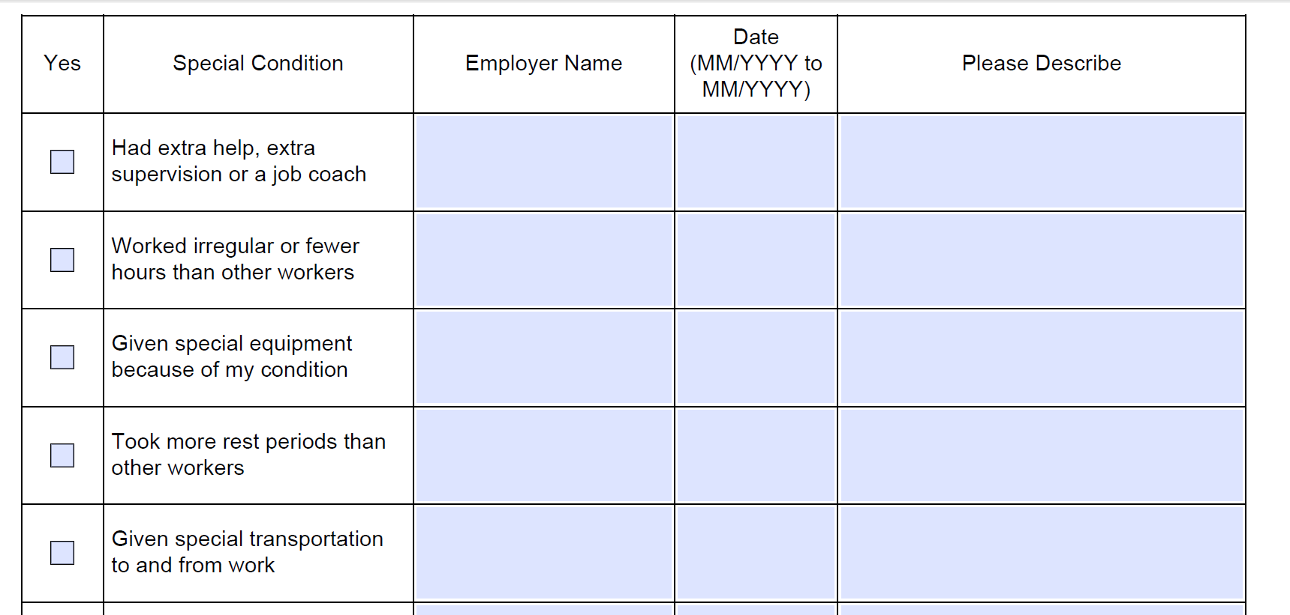
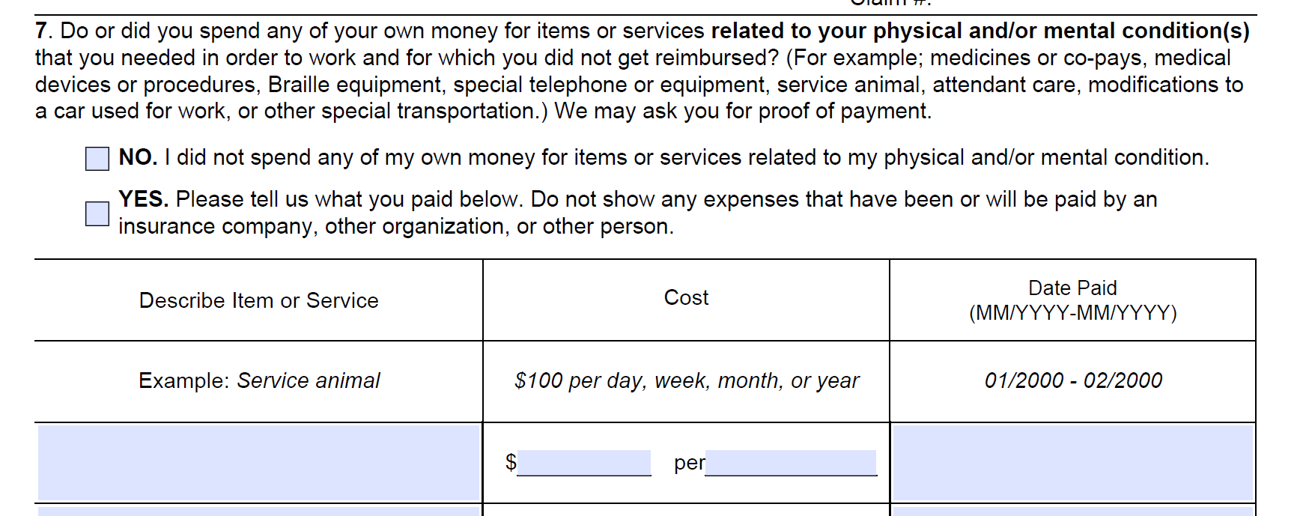
Form SSA-821 Work Activity Report
SSA-821 is used to document work activity and work incentives when SSA is making SGA decisions.
https://www.ssa.gov/forms/ssa-821.pdf
Beneficiaries complete this form to document special conditions, subsidies and IRWEs so decisions are based on the real value of the work.
www.socialsecurity.gov

Slide 32
SSDI ONLY EMPLOYMENT SUPPORTS
Trial Work Period (TWP)
Extended Period of Eligibility (EPE)
Continuation of Medicare
www.socialsecurity.gov
Notes:
Page 30 of the Red Book
Page 35 is a great summary of SSDI employment support snapshot

Slide 33
Trial Work Period (TWP)
The TWP allows SSDI beneficiaries to test their ability to work and:
Receive full SSDI benefits regardless of earnings
TWP starts when gross earnings are more than $910 for 2020 or work more than 80 hours in self-employment in a month
TWP continues until 9 TWP service months accumulate (not necessarily consecutive) within a 60-month rolling period
www.socialsecurity.gov

Slide 34
Extended Period of Eligibility (EPE)
EPE is 36-month re-entitlement period
During the EPE:
-If work or monthly earnings are below SGA, benefits are payable
-If work or monthly earnings are above SGA, benefits are suspended
EPE begins with the first month after the TWP ends.
If work is over SGA after EPE, benefits terminate.
www.socialsecurity.gov

Slide 35
Extended Period of Eligibility (EPE)
Month TWP ends (T9)
Month EPE Begins (E1)
Re-entitlement Period Ends (E36)
EPE Continues (E37 - On)
9-Month
Trial Work Period
36-Month
Re-Entitlement Period
EPE continues until
SGA is preformed after the 36th
month
www.socialsecurity.gov

Slide 36
Continuation of Medicare Coverage
Although cash benefits may cease due to work, continued health insurance is possible.
Most beneficiaries who work will continue to receive at least 93 consecutive months of Part A; Part B (if enrolled); and Part D (if enrolled). There is no premium for Part A.
The 93 months start the month after the last month of the TWP.
To qualify, beneficiary must already have Medicare and be working at SGA level but not medically improved.
www.socialsecurity.gov

Slide 37
SSDI- Summary of Returning to Work
The Trial Work Period
Lasts for 9 months
Does not have to be 9 consecutive months
Must take place within 60 months
The Extended Period of Eligibility
36-month re-entitlement period
Under SGA, cash payment received; Over SGA, no cash payment
Benefits will terminate if over SGA after EPE re-entitlement period
Medicare
If disability payments ended due to work, coverage will continue if disability still meets rules
Can continue for at least 93 months after TWP ends
www.socialsecurity.gov

Slide 38
SSI ONLY EMPLOYMENT SUPPORTS
Earned Income Exclusion
Student Earned Income Exclusion (SEIE)
Special SSI Payments for Persons Who Work- Section 1619(a)
Medicaid While Working- Section 1619(b)
www.socialsecurity.gov
Notes:
Pages 36-42 of the Red Book

Slide 39
Income Exclusions
SSA does not count the first $65 of the earnings received in a month, plus one-half of the remaining earnings. This means we count less than one-half of earnings when we figure the SSI payment amount.
We apply this exclusion in addition to the $20 general income exclusion.
We apply the $20 general income exclusion first to any unearned income received.
https://www.ssa.gov/OACT/COLA/incomexcluded.html
www.socialsecurity.gov

Slide 40
Earned Income Exclusion
Example 1- Earned Income Only
Total monthly income
= $385 (Gross wages)
$385 (Gross wages)
-85 (Not counted)
=$300 divided by 1/2 =$150
(Countable income)
$783 (SSI Federal Benefit Rate)
-150 (Countable income)
=$633 (SSI Federal Benefit)
Example 2- Earned Income and Unearned Income
Total monthly income
$200 Gross wages
$185 SSDI benefits
=$385 Total
$185 SSDI
$20 (general income exclusion)
= $165 countable unearned income
$200 Gross wages
$65 earned income exclusion
=$135 divided by ½ = $67.50 countable earned income
$783 (SSI Federal Benefit Rate) – $165 (countable unearned income) = $618 - $67.50 (countable earned income) = $550.50 (SSI Federal Benefit)
Although SSI benefits will be reduced, overall income will be more when a beneficiary is working!
www.socialsecurity.gov

Slide 41
Student Earned Income Exclusion
For individuals under age 22 and regularly attending school, we do not count up to $1,900 of earned income per month when we figure the SSI payment amount. The maximum yearly exclusion is $7,670.
Regularly Attending School-
In a college or university for at least 8 hours a week; or
In grades 7-12 for at least 12 hours a week; or
In a training course to prepare for employment for at least 12 hours a week (15 hours a week if the course involves shop practice); or
Home schooling if instructed in grades 7-12 for at least 12 hours a week
https://www.ssa.gov/ssi/spotlights/spot-student-earned-income.htm
www.socialsecurity.gov

Slide 42
Section 1619(a)
A beneficiary can receive SSI cash payments even when earned income is at the SGA level.
To qualify, a beneficiary must:
Have been eligible for an SSI payment for at least 1 month before SGA level work begins; and
Still be disabled; and
Meet all other eligibility rules, including income and resource tests.
Under 1619(a), a beneficiary can receive their gross income from wages, an SSI payment (calculated based on wages) and Medicaid.
www.socialsecurity.gov

Slide 43
Section 1619(a)
Example
Beneficiary has been receiving SSI for six months and returns to work making $1300 per month in gross wages.
$1300 (gross wages)
$20 (general income exclusion)
= $1280
$65 (earned income exclusion)
= $1215 divided by ½ = $607.50 (countable income)
$783 (Federal Benefit Rate) - $607.50 (countable income) = $175.50
www.socialsecurity.gov

Slide 44
Section 1619(b)
After returning to work, Medicaid coverage can continue even if earnings become too high for an SSI cash payment.
To qualify, a beneficiary must meet ALL of the following:
Were eligible for an SSI cash payment for at least 1 month;
Would be eligible for cash payment except for earnings;
Still be disabled;
Still meet all other eligibility rules, including the resources test;
Need Medicaid in order to work; and
Have gross earned income that is insufficient to replace SSI, Medicaid, and any publicly funded attendant care.
Under 1619(b), a beneficiary will receive income from gross wages and Medicaid but no SSI payment.
https://www.ssa.gov/disabilityresearch/wi/1619b.htm
www.socialsecurity.gov

Slide 45
Reporting Work
Online: You can create a free my Social Security account to use the online wage reporting tool, whether you receive SSI, SSDI or both.
Mobile App: If you receive SSI, you can download the SSI Wage Reporting app onto your smartphone, which allows you to ealily report your wages.
Telephone Wage Reporting: If you receive SSI, you may be able to report your monthly wages over the telephone. Please contact the local Social Security office to see if this option can work for you.
Your local Social Security filed office: You can mail or fax your paystubs to your local Social Security field office.

Slide 46
Overpayments
An overpayment happens when you receive a higher cash payment from Social Security than what you were owed for that month.
If you have been overpaid, you are responsible for paying it back to Social Security.
If you think you have been overpaid, don’t spend the money! Social Security will send you a notice explaining the overpayment with a request for you to repay the amount within 30 days of the notice.
If receiving SSDI, Social Security will withhold the full amount of your benefit each month, unless you request a lesser withholding amount.
If receiving SSI, Social Security will withhold 10% of the federal benefit rate each month to recover the overpayment.
If you don’t agree that you have been overpaid or if you believe the amount is incorrect, you can file form SSA-561 for an appeal. Must submit within 60 days from when you receive the overpayment notice.
Another option is the filing form SSA-632, Request for Waiver of Overpayment Recovery. There is no time limit for filing a waiver but you must prove that the overpayment wasn’t your fault and that paying the money back would cause you financial hardship.
Notes:
Reporting wages every month helps you to avoid being overpaid.

Slide 47

my Social Security

Slide 48
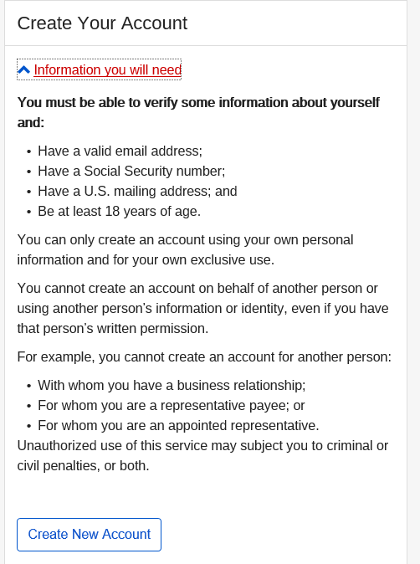

Slide 49
Key Transactions with a
my Social Security account
Request a Replacement Social Security Card
Get a Benefit Verification Letter
Check Application Status
Online Wage Reporting

Slide 50
Contacting Information
Hillary Hatch
Area Work Incentive Coordinator
Grand Rapids, Michigan
1-877-322-5883 ext. 18873
Hillary.hatch@ssa.gov
www.socialsecurity.gov

Slide 51
Contacting Social Security
Visit the website
www.socialsecurity.gov
Call the toll-free number
1-800-772-1213
Specific questions can be answered from 7 a.m. to 7 p.m., Monday through Friday. Information is provided by automated phone service 24 hours a day.
If deaf or hard of hearing, call Social Security’s TTY number, 1-800-325-0778.
Visit a local office
Most offices are open to the public Monday, Tuesday, Thursday and Friday from 9 a.m. to 4:00 p.m. and Wednesdays from 9 a.m. to 12:00 p.m., except Federal holidays.
www.socialsecurity.gov

