Slide 1
The Fundamentals of Autism
Putting the Pieces Together Parenting Workshop
Michael Wolff, PsyD, ABPdN, Jennie Reminga, LMSW,
Thomas Denczek, LMSW, Sean Crowell, MS, OTR/L,
and Brianna Kuhatschek, M.Ed, BCBA

Slide 2
Tips to Reduce the Stress of Daily Living Skills
Create a consistent routine
Break the task down into small steps
Use visuals, modeling, prompting, and practice
Work toward independence in a specific area
Provide breaks and calming strategies prior to problem behavior
Support advocacy
Celebrate small victories

Slide 3
Adolescent/Adult Transitions Lower vs HF-ASD
Future low
School up to 26 yrs old
Live with family members until transition to Adult Care
Possibly supported community living
Guardianship
Disability
Vocational workshop
Structured activity through support organizations
Future HF
Graduate HS
Anticipated to join the work force
Videogames
Many will go to college or receive specialized training
Computer science/Programming/Tech
Engineering
Physics, chemistry, some medical areas

Slide 4
Tips to Reduce the Stress of Transitions
Utilize resources and ask questions
Advocate, advocate, advocate
Accept help
Plan early and often
Be involved in IEP meetings
IDEA requires transition goals be identified as your child prepares to leave the public school system
Notes:
Plan early and often - talk about goals short term, long term and reviewing those frequently

Slide 5
Tips to Reduce the Stress on Relationships
Create positive interactions with all family members by pairing
Develop appropriate social scripts and routines
Set boundaries and expectations for behaviors
Look at the function
Teach skills
Provide reinforcement, not bribes!
Once skills are taught, follow through

Slide 6
Tips to Reduce the Stress that Can Accompany Behaviors
Determine the “most important”
Do not attempt to change everything
Work together and respond consistently
Share the burden
Give space if needed

Slide 7
Tips to Reduce Employment and Financial Stress
Request flexibility and explain why
Focus on what your child needs
Set reasonable expectations and give yourself grace!
Find a support group (virtually or in person)
It is OK to get away!
BRAINS has provided parents with ‘Date Nights’ in the past
Respite providers, camps, home help
Ask about scholarships and resources often

Slide 8
Regardless of ASD severity
Technology can have catastrophic consequence if not closely managed.
It is not necessarily an addiction in the classic sense with ASD, rather it becomes a Fixation and Special Interest.
It can become a surrogate world
It can become perceived as their social work
Trying to manage too late can result in severe aggression, assault, psychiatric hospitalization or legal involvement.
Promote and reward transitions from technology.

Slide 9
Treatment and Resources

Slide 10
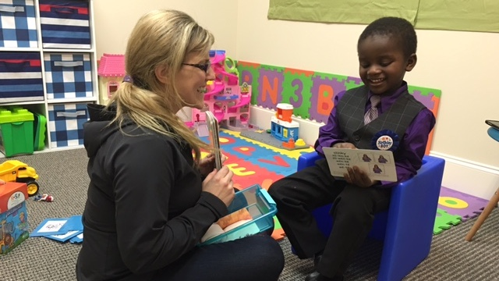
Treatment Tendencies Lower vs HF-ASD
SLP low
Work is first on trying to gain some form of communication, verbal, sign, technology option
Gain interest in communication for needs
Once communication is developed, focus on length of verbalization
How to listen to others receptively for commands
Then expand to hopeful social communication at some level
SLP HF
Focus is often on content
Reducing bluntness and how to say things more appropriately
Differentiating irony, sarcasm, appropriate jokes
How to engage in conversation, NOT just about their focal area of interest
Job interview skills

Slide 11
Treatment Tendencies Lower vs HF-ASD
OT low
Learning to crawl, alternate movements, walk
Learn skills to manage silverware, dress, consult on bathroom training
Learn to color, draw progressing to numbers and letters
Gain comfort with movement
Sensory/Movement
Sensory related diet factors texture, taste, smell
Individual therapy typically 1-2x/wk
OT HF
Advance ability to manage variety of clothing
Sensory challenges
Spatial organization and planning
Meal planning/prep
Independent life skills
Benefit from individual, group, or therapy on a consultative basis

Slide 12
Treatment Tendencies Lower vs HF-ASD
Medication low
Used more often to manage self-injury (biting, head banging, aggression)
Address sleep
More often atypical antipsychotics used
If ineffective, mood stabilizers like Depakote seen
Medication HF
More routinely see Alpha2 Agonists
SSRI’s
Mood stabilizers like Lamictal
https://www.autismspeaks.org/tool-kit/atnair-p-autism-and-medication-safe-and-careful-use

Slide 13
Treatment Tendencies Lower vs HF-ASD
Behavioral Health low
ABA often intensive, in home, up to 40 hours a week
Goals are often on increase use of basic skills while decreasing high risk behaviors
Follow basic commands
Individual therapy focuses on play and social skills
Family counseling to support caregivers
Behavioral HF
ABA can be appropriate for skill acquisition, peer interaction, daily living and executive functioning skills
Outpatient behavioral services
Groups
Really need to focus executive functioning skills, social interaction, communication
Peer to peer

Slide 14
Additional Resources
Scholarships
Autism Care Today
Family Hope Foundation
Small Steps in Speech
Michigan Rehabilitation Services
Job coaching for competitive integrated employment
Project SEARCH
Autism Speaks
Toolkits
Autism Alliance of Michigan
Disability Advocates of Kent County
Network180
Community Mental Health of Kent County
Dan Blauw
Attorney specializing in special needs trusts, guardianship and power of attorney
M.O.R.G.A.N Project
Parent to Parent USA
Notes:
https://www.autismspeaks.org/tool-kit?resource_type[606]=606&resource_type[606]=606&state[271]=271

Slide 15
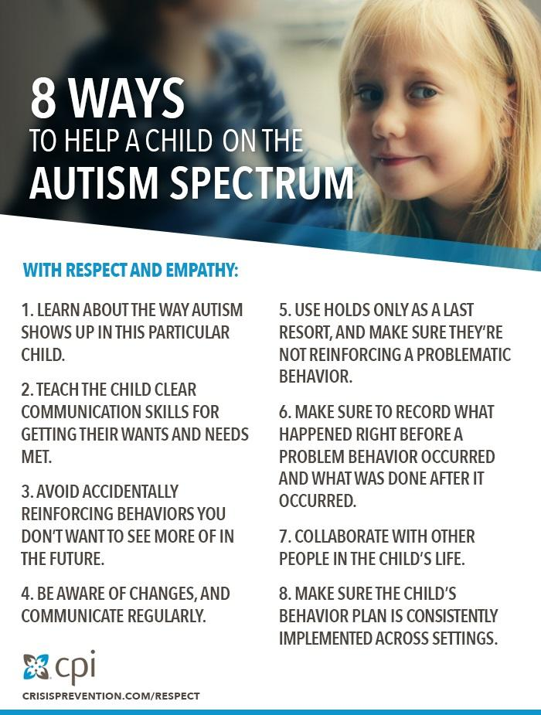

Slide 16
https://www.taylorfrancis.com/books/e/9780429454646

Slide 17
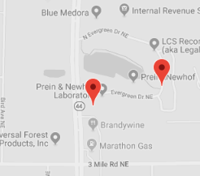
BRAINS Main Campus
3292 N. Evergreen Dr. NE
Grand Rapids, MI 49525
Adult & Adolescent Clinic
2900 E. Beltline Ave NE
Suite F
Grand Rapids, MI 49525
P: 616.365.8920
F: 616.365.8971

Slide 18
brainspotential.com

